Slide 1
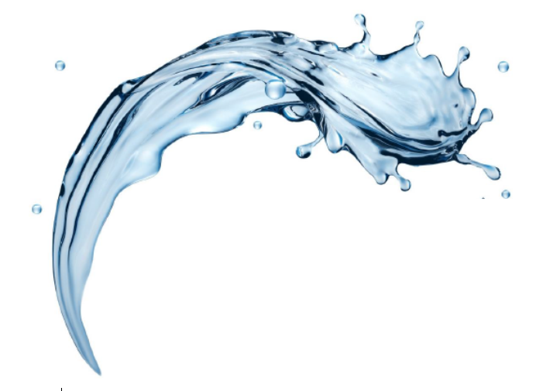

FilterSorb SP3
Texture of Water: Part III
-by Deepak Chopra

Slide 2

A Natural Mineral Water
As you already know, hard water has a high mineral content. The minerals are mostly metal ions such a s calcium and magnesium in the form of carbonates.
CaCO3 and MgCO₃
Carbone Dioxide Changes the Texture of Water
As everybody knows that there is a huge difference in the solubility of carbon dioxide in
Soft Water vs. Hard Water

Slide 3
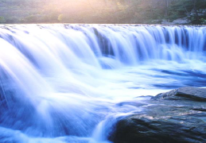
Carbone Dioxide and Water Texture
As I know that Carbon Dioxide solubility is just ZERO in water with high salinity. And after Water Softeners as salinity increases and the carbonation comes to an end and this is a function of difference in solubility. It is because that the carbonation is bound (ionic ions) to metals in the water- such as the carbonates described and are therefore HARD TO REMOVE!
Learn more on Next slides about the real Healthy Water
-by Deepak Chopra

Slide 4
SP3 Water for Drinking
Minerality
Still
Effervescent
Balanced Levels of carbonation
CaCO3
H2O
Carbonated CO2
Minerality of Water is determined by the minerals in contain. Calcium and Magnesium Carbonate (MgCO₃ and CaCO₃) are the best choice. They give texture but does not overpower minerals like potassium, sodium, sulfate, silica, bicarbonates and trace minerals that the human body needs. Lead and Copper are removed by SP3 media in all contents and concentrations.

Slide 5

SP3 Water for Drinking (continude...)
A Natural Mineral Water
Gases, colloids or sediments are not included in the minerals measurement. After mouth-feel, Minerals are the second most important factor in matching with healthy food. The higher mineral water falls in the category of Classic Water. Classic Waters are the workhorses of the food and water pairing. Their mouth-feels matches many dishes perfectly, which makes them a safe bet. Classic Water are also perfect for coffee and mixed drinks. If you have less minerals then SP3 water is a good choice for mixed drinks while one with a higher minerals would be perfect choice with steaks and meats.

Slide 6
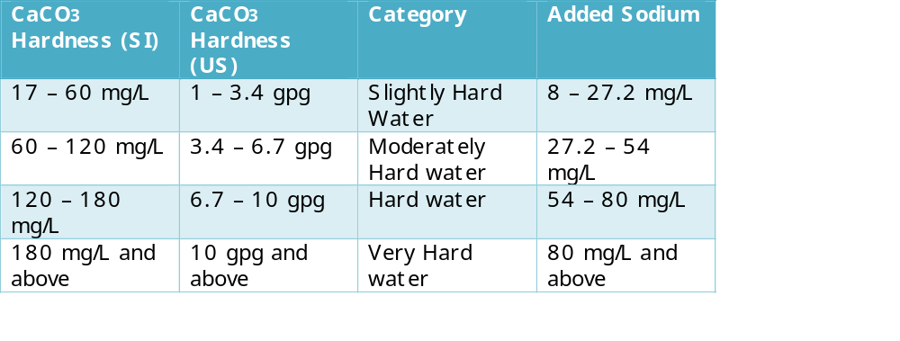
CaCO₃ Hardness with SP3 Water
Calcium and Magnesium levels combine the mineral water‘s „HARDNESS“.
All bottled water should be naturally hard, thanks to Calcium and Magnesium.
Sodium water for Water Softeners
When water is softened with ion-exchange water softener, it adds sodium to the water. About 8 mg/L of sodium is added for every grain of hardness. Environment Protection Agency (EPA) has new Sodium level regulation in drinking water which is 20 mg/L.
Most of the waters have CaCO3 equivalent over 300 mg/L (16 gpg)! That adds over 128 mg/L of Sodium after softening which is over 6.4 times higher than the recommendation.

Slide 7
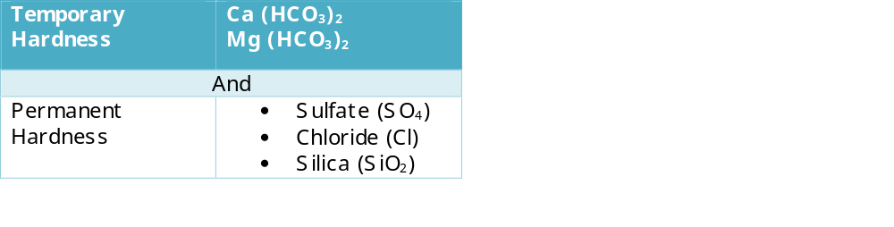
SP3 Water is Structures Water
Structured Water = H₂O 100% natural
100% natural watres are always available
on taps. Hard tap waters Contains two kinds
of hardness
Hardness – Ca(HCO3)2 water makes scaling in pipes, hot water appliances, dishwashers, washing machines, showers, taps and makes cleaning more difficult and more dependent on soaps and synthetic detergents. Scaling in boilers, heat exchangers and coffee machines comes from hard water. But hard water when passes through SP3 media opens the bracket of Ca(HCO3)2 and changes in no time changes its TEXTURE to
Non Soluble → CaCO3 Calcium & Magnesium minerals
Pure Water → 100% natural H2O
Naturally → Carbonated with CO2

Slide 8
Without changing its Orientation (pH)
pH of the water is most important factor in all “Drinking waters”. The pH (for potential Hydrogen) measures the substance’s level of acidity or alkalinity. On the pH scale 1.0 to 6.8 is acidic and is not recommended for drinking or making whatsoever drinks. pH between 6.9 and 7.2 is nearly neutral and 7.2 to 14 is alkaline (or basic). All natural waters or low alkaline waters (pH 7.2 to 7.5) are best for human consumption. They tastes neither sour nor bitter but best for human tongue. Since pH is a Logarithmic scale, the difference of 1 degree indicates a tenfold increase or decrease in acidity or alkalinity. Water from weak acid cations with a pH of 5 for example is 10 times more acidic than that of a pH of 6 and so on.

Slide 9
Structured Water
Definition: When water is unadulterated means only structured as follows
Ca(HCO₃)₂ → CaCO₃ + H₂O + CO₂
Nothing added or subtracted and 100% natural.
This in turn means this H₂O (water molecule) has its outer electron shell intact, i.e. in equilibrium and without a charge. This is a structural water, a water without the change in pH, without adding high sodium content, a water that you will feel and see can penetrate the body’s cells with ease and therefore cleanse your cells and re-hydrate your body’s cells much more easily. It is this cleansing of your cells that give you a better, healthier and happier life.

Slide 10
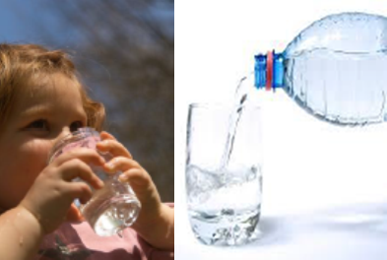
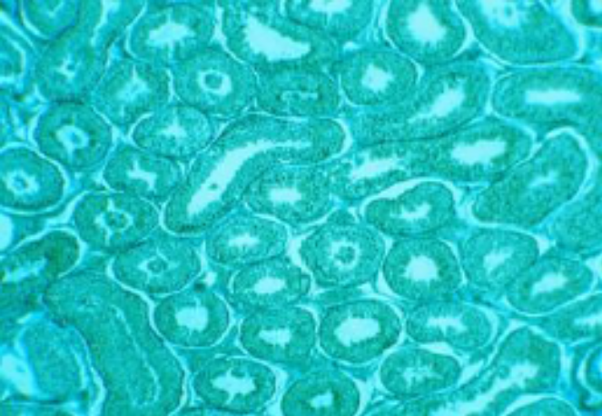
TDS as a function of cell hydration property
Lower the TDS (Minerals) the greater the cell hydrating properties of the water. All healthy cells are surrounded by (“structural water”). And all natural waters are naturally carbonated those are treated with FILTERSORB SP3. All mineral waters with its unique mineral composition those are reputed to have beneficial properties for health.

Slide 11


Effect of minerals on your health
Compared to most of the wines, differences in taste between waters are quite subtle. But they are nevertheless discernible: Local geological strata impart water with different minerals, giving each and every single source of drinking water a unique set of minerals.
Herewith we describe the most healthiest minerals found in SP3 water the benefits these minerals can provide

Slide 12
Magnesiúm for Human Body
Magnesium (Mg⁺⁺)
Almost all human cells have some level of magnesium in them and all adults need four hundred milligrams (400 mg) of Mg⁺⁺ everyday. Magnesium is very important for the regulation of muscle contractions and the transmission of nerve impulses and its activation energy for producing enzymes. Human beings’ complete bone structure relies on Mg⁺⁺ and the expansion blood vessels, which reduces the risk of heart attack. All sickness are related to magnesium deficiency. Nervousness, lack of concentration, dizziness and headaches or migraines are related to high SODIUM in water and lack of magnesium. All waters have below 50 mg/liter of Mg⁺⁺ therefore AMG (Adds Magnesium is important) to install (500 - 600 mg/liter) of Mg⁺⁺ in healthy drinking water. It is a revolution in all Drinking water history.
Upcoming next: AMG Filters

Slide 13
Calcium (Ca⁺⁺) only Sp3 can do
It is a fact that every adult needs about 800 mg of Ca⁺⁺ per day – babies don’t require more than 300 mg/day but all youngsters between fifteen and nineteen year olds need significantly more.
Soft Water has no Magnesium (Mg⁺⁺) and Soft Water has no Calcium (Ca⁺⁺) and 7.8 mg/L of Sodium is suitable for all heart patients. The metabolism and regular contraction of heart is affected by sodium.
The many benefits include its stabilizing bone structure, teeth and cell membranes, ensuring nerve and muscle impulses are properly transmitted and helping to prevent blood clotting. Calcium also has a balancing effect for numerous skin allergies. Bone decalcify (osteoporosis) and fractures become more likely if a body is not getting enough calcium. Best water for drinking should have 200 mg/liter to 400 mg/liter calcium.

Slide 14
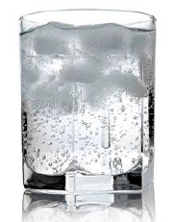
Carbonation Level of Best Drinking Water
Effervescent: Effervescent waters are an epicurean surprise to many. FILTERSORB SP3 water is very sophisticated water, with the smallest possible bubbles of (CO₂), straddle a line between STILL and LIGHT SPARKLING water.
Carbonation: 2 mg/liter – 5 mg/liter
Use SP3 water to surprise to contrast a dish with a water pairing. Recommended serving temperature: 12°don’t like sparkling water at all will love Light C / 54°F You will notice all those people who claim they don’t like sparkling water at all will love Light Sparkling water made by SP3.

Slide 15
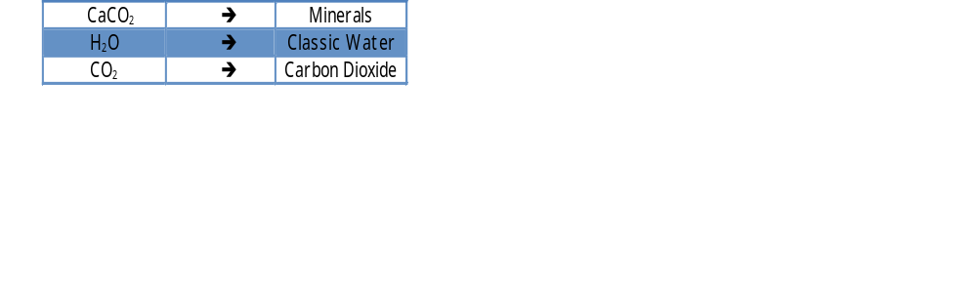
What is Water Texture?
Natural carbonated water is water that contains CARBON DIOXIDE GAS (CO2). The natural gas in temporary hardness Ca(HCO3)2 when comes into contact with solid particles of SP3 media creates:
This CO2 gas creates bubbles in the water (H2O), leading to an effervescent TEXTURE that
everybody find quite enjoyable in drinking water. This water is known as “Light Sparkling Effervescent Water” or SP3 water. In its simplest form, it is essentially identical to healthy still water. Natural carbonated water has thousands of examples and they have been consumed for centuries by people who believed that this is the only water, which has provided many Health Benefits.
End of Part III
Thanks for reading!

Slide 16
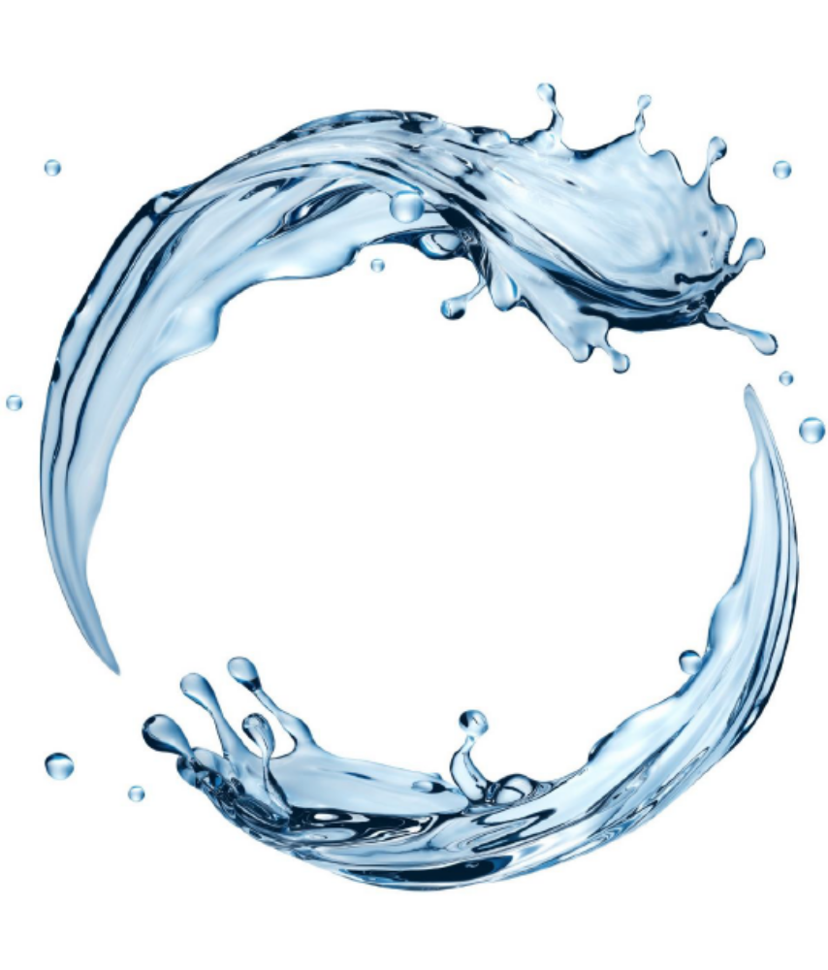

Watch Water® GmbH
Fahrlachstraße 14
68165 Mannheim
Germany
www.watchwater.de
info@watchwater.de
+49 (o)621 87951-0

