Slide 1
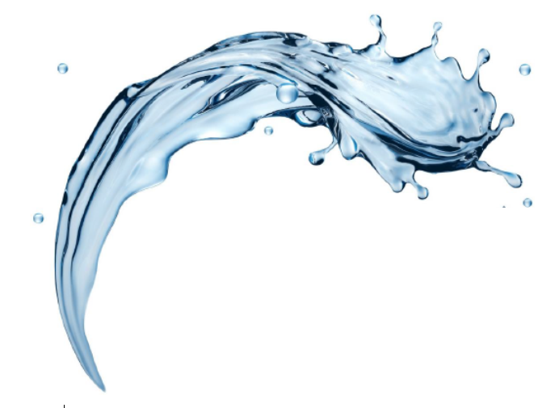

FilterSorb SP3
Introduction: Part IV
-by Deepak Chopra

Slide 2

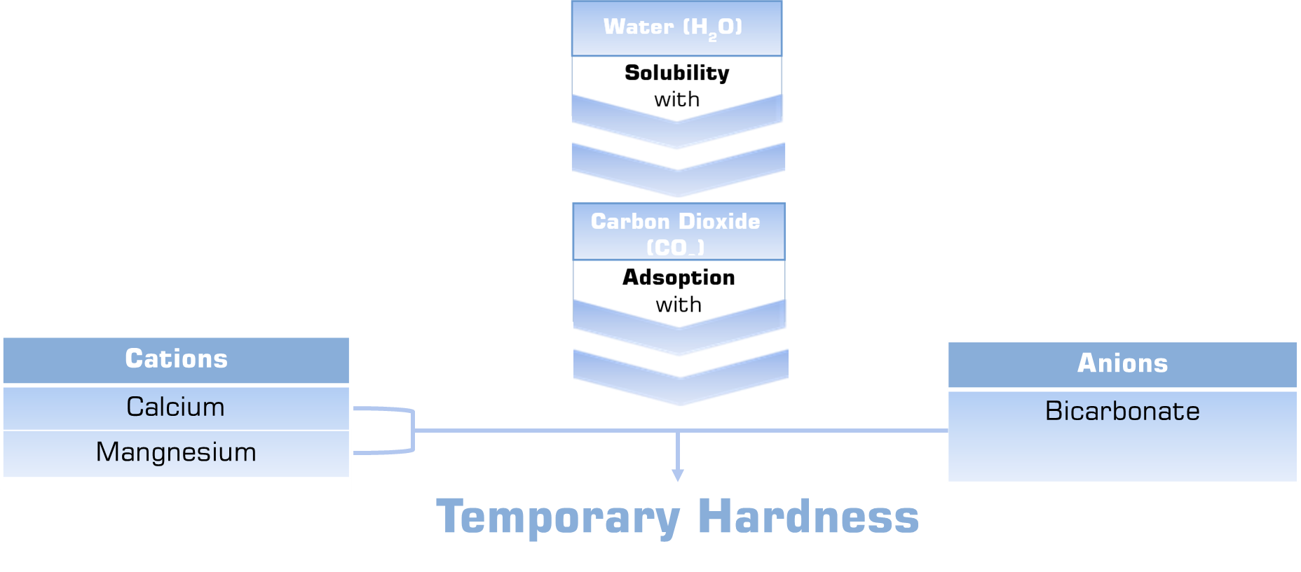
Cleaning, Washing and Bathing with CO₂
Solubility and Adsorption of

Slide 3

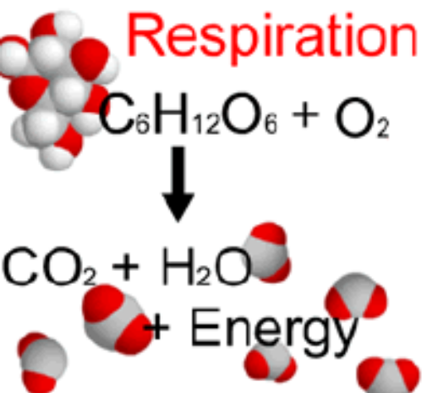
What is „Natural CO₂“
The Natural CO₂ in the atmosphere which dissolves in the water mostly come from the „respiration“ of all living things. Every time a person breathes out, he or she exhales CO₂ which lungs have removed from the blood stream, where it is the waste product left when cells burn carbohydrates to make „Energy“. The microbes that break down the dead plant matter in soil, release CO₂ as they digest it. The biggest source is plant respiration.

Slide 4

Natural CO₂ and Skin
The permeability of carbon dioxide (CO₂) against a cell membrane for example is 25 times greater than oxygen. Carbon dioxide easily dissolves in water (H2O) and also easily in oil. It is one of the reason that Carbon dioxide is easily absorbed from the skin, whick has a structure like a mixture of water and oil. Skin blood flow is improved by blood vessel dilation; therefore skin cell metablism is activated and generally speaking skin become healthier. Beautiful skin has to be healthy skin first. That explains one of the reasons skin becomes more beautiful by Carbon Dioxide absorption.
Read more on Part V
Adsorption of Carbon Dioxide
THROUGH SKIN
We use the term „Carbon Dioxide Gas“ for better understanding of non-experts.

Slide 5
Solubility and Adsorption of carbon dioxide
As you have learned in previous lessons carbon dioxide easily dissolves in water (H₂O) and also emits from water. At room temperature CO₂ can exist in a form of a gas and is therefore used to carbonate soft drinks and other beverages. Natural CO₂ can also exist in Temporary hardness Ca(HCO₃) dissolved in CaCO₃ + H₂O + CO₂, as liquid. Liquid CO₂ has a gas like consistency and a low surface tension allowing it to function as a very effective cleaning medium when combined with detergents. The SP3 system uses a specially designed pressure vessel and a granular beads which separates the liquid CO₂ from Calcium bicarbonate just before entering washing machines and dish washers and creates a gentle wash in this process of cleaning. It needs a less heating of the machines 30°C for the cloths and is therefore gentle to fabric. After a cycle time of 40 – 50 minutes, the cleaned garments are removed from the washing machines.

Slide 6
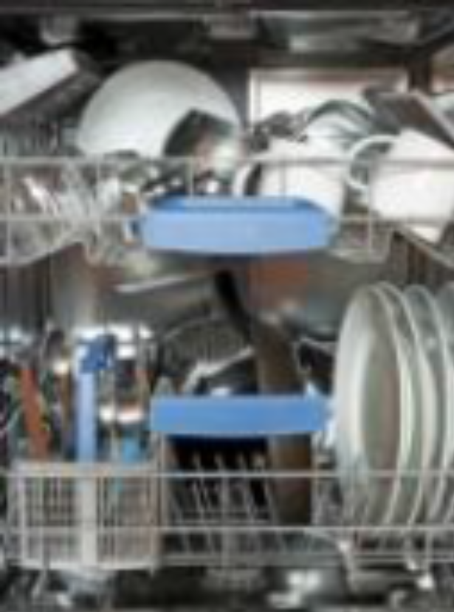
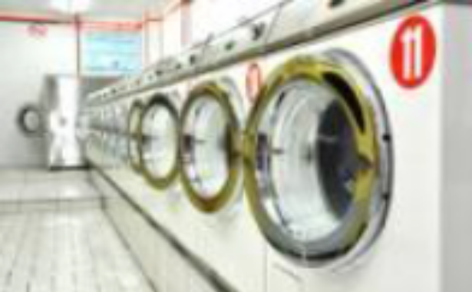

Performance
An independent performance testing has been conducted with great results. The performance information that is presented in study was provided by Tensio Consult, Germany.
Watch® Water Technologies SP3 system offers excellent cleaning performance across most garment components and a wide range of stains and soils. Also, since CO₂ works best at room temperature, energy saving is huge cost savings.

Slide 7
Environmental, safety and health Impact
Naturally occurring Carbon dioxide is generally available in all hard waters.
Read Texture of water with CO₂, Part lll
The use of SP3 water with CO₂ allows consumers and washing machine operators to avoid exposure to traditional dry cleaning solvents. The FILTERSORB SP3 systems are used to make beverage classic waters and more than 50,000 systems are installed in different restaurants and other fountain beverage dispensers located across the world.
Environment stewardship is one of the hallmarks of Watch® Water SOFT-NO-R system. The wastewater generated by the SP3 system is ZERO and does not use salt or chemicals for regeneration.
Because the SP3 media works in residential and commercial applications. The SP3 media is working under pressure all pressure vessels have ASME code for pressurized vessels and system. SP3 has been tested to meet NSF 61 (USA), WRAS (UK), BS6920 (UK) and MSZ 448-36:1985 (Hungary) standards.
SP3 media is absolutely Non toxic!

Slide 8
Capital Cost Comparison:
A primary concern for individuals considering the use of CO2 for :
  Cleaning
  Washing
  Bathing and
  Drinking water
in comparison to water softeners is almost same but there are no further operating costs and the high productivity associated with the SP3 system ensure adequate return on investment in one month up to maximum one year depends on the size of SP3 system.
Better for you and better for Environments!

Slide 9
How does CO₂ cleaning work?
CO2 in SP3 water uses natural carbon dioxide (recycled from temporary hardness) combined with recyclable cleaning agents (specially formulated by Watch Water) to wash the dirt, particulate and toxins from garments,(than flushing the waste into drain) with all 100% biodegradable components. Oh! did we mention the SP3 Systems and the whole process is powered without any energy - pretty high tech stuff!
The entire cleaning process is done at a cool, room temperature. Other cleaning chemicals like phosphates, silicates, hydrocarbon, chlorine for bleaching are toxic chemicals that are known as carcinogens adds up back to surface and ground water contaminants. Additionally, most other processes and cleaners require High Heat to clean clothes. Heat degrades fabrics causing them to wear out, fade and pill and can actually cause stains to set permanently. Our SP3 water with CO₂ gets clothes cleaner than any other cleaning method. With CO2 in water there’s no fading, shrinking, pilling or stain setting. Pure CO₂ in SP3 water leaving garments fresh, odorless and toxin free.
Sounds Great!!

Slide 10
Wash and rinse your clothes in colde water
SP3 water with CO₂ cleans in cold water Temperature maximum 30°C or 86°F the same as hot water. Your clothes will come out just as clean using cold SP3 water as they would using hot water, even better and whiter. That’s because there are three factors in cleaning, less TDS (high TDS caused by water softeners), better detergents and the CO₂ for better Texture (more on Part III). Take away heat that is not needed. Ask for more details on Watch formulated Green detergents which works extremely great and are specially designed to be more effective in cold water as old detergents made from phosphate, silicates, chlorine for hot waters.
TAKE ACTION! How to install SP3 system at HOME
Thanks to FILTERSORB SP3 !
End of Part IV
Thanks for reading!

Slide 11
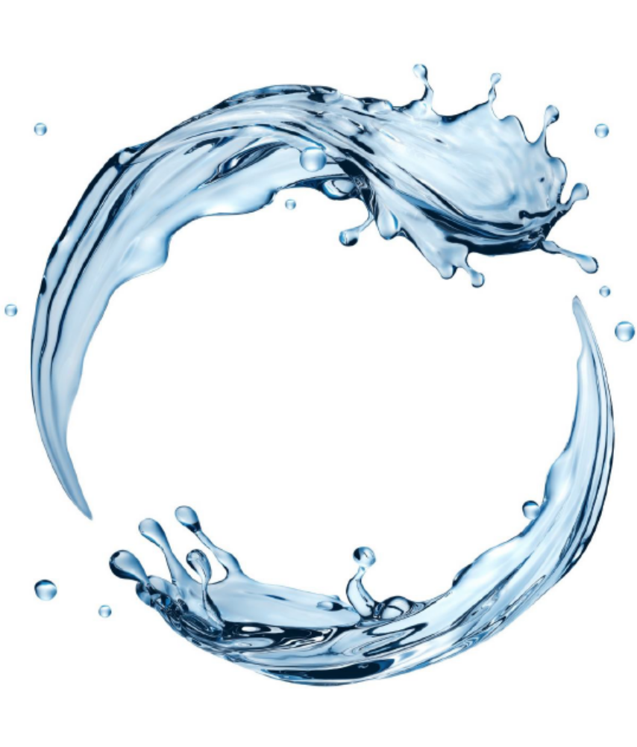

Watch Water® GmbH
Fahrlachstraße 14
68165 Mannheim
Germany
www.watchwater.de
info@watchwater.de
+49 (o)621 87951-0

