Slide 1
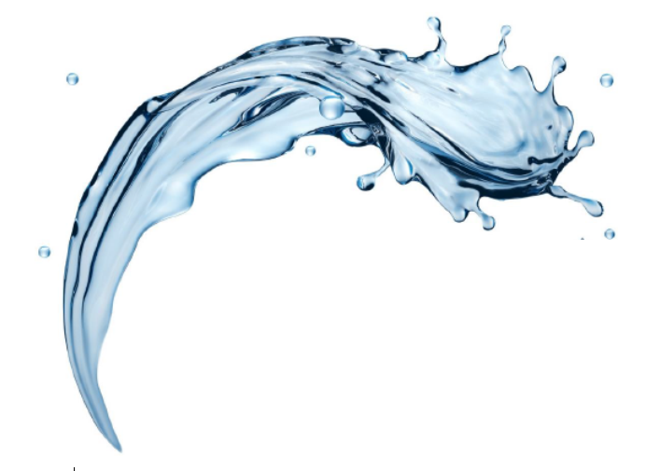

FilterSorb SP3
Removal of Scales: Part V
-by Deepak Chopra

Slide 2

On-line Cleaning and Removal of Hard Scale
By Carbon Dioxide (CO2) made by FILTERSORB SP3
The Carbonate cycle is dynamic process.
Photosynthesis & respiration can change the pH of a system by adding or removing CO2.
pH affects many aspects of water treatment including: disinfection, scale formation and corrosion potential.
the interaction among pH, alkalinity and hardness has far reaching effect on water treatment.
A basic knowledge of general water chemistry relationships can provide a better understanding of water treatment processes.
Don’t worry about equations & formulas – that’s what books are for. It’s far more important to understand the processes behind the equations.

Slide 3
Application of FILTERSORB SP3 Systems to Dissolve the Line Scale On-line
CHEMISTRY OF THE SYSTEM
In SP3 System, as the pH of the system adjust to normal 7.5, the solubility of LIME SCALE increases.
Equation Fig. 1 shows the chemical equilibrium between CO₂ and lime scale.
CaCO₃ (s)+ CO₂ (g)+ H₂O <-> Ca²⁺ (aq)+ 2HCO₃⁻(aq)
The concentration of
H₂CO₃- is highly pH – dependent
and tends to be at its maximum at a pH of approximately 8.3
Fig. 1
CO₂ Carbon dioxide H₂CO₃ Carbonic acid | HCO₃- Bicarbonate Ca(HCO₃)₂ Calcium bicarbonate | H⁺ Hydrogen ion OH⁻ Hydroxyl ion
CO₃²⁻ Carbonate | CaCO₃ Calcium carbonate | PO₄³⁻ Phosphate ion

Slide 4
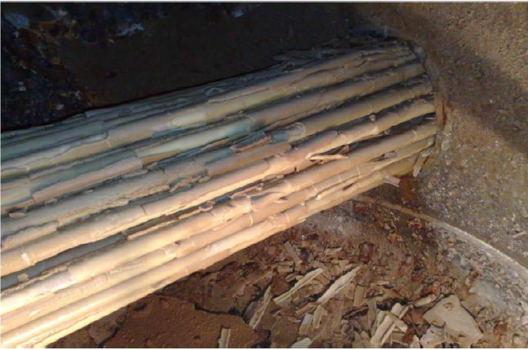
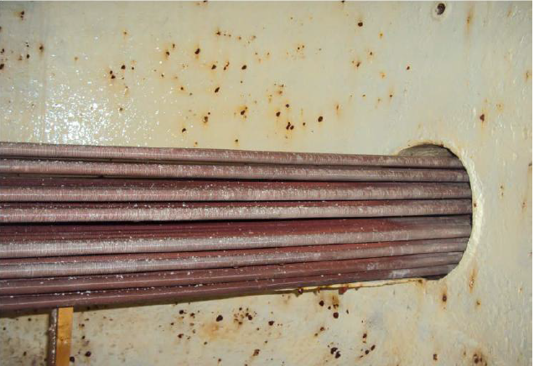
Introduction
Almost all Heat exchangers, Cooling towers, Evaporators has a history of getting plugged with formation of lime-scale. Excessive scale formation is a result of significant capital, maintenance and operating costs over the years. Complete plugging of tubes is a result of equipment failure, which can force all Industrial plants and processes to operate at suboptimal temperature conditions.
After 8 months of
SP3 treatment
Before SP3 treatment

Slide 5
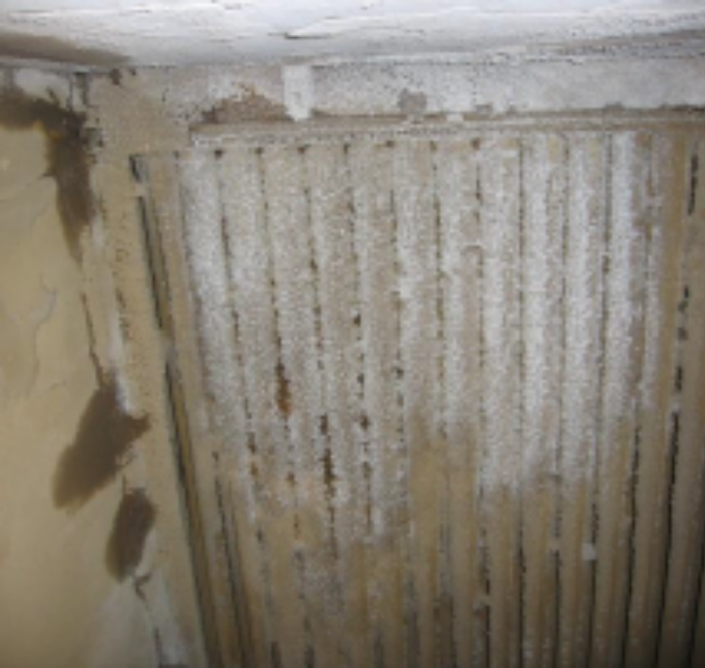
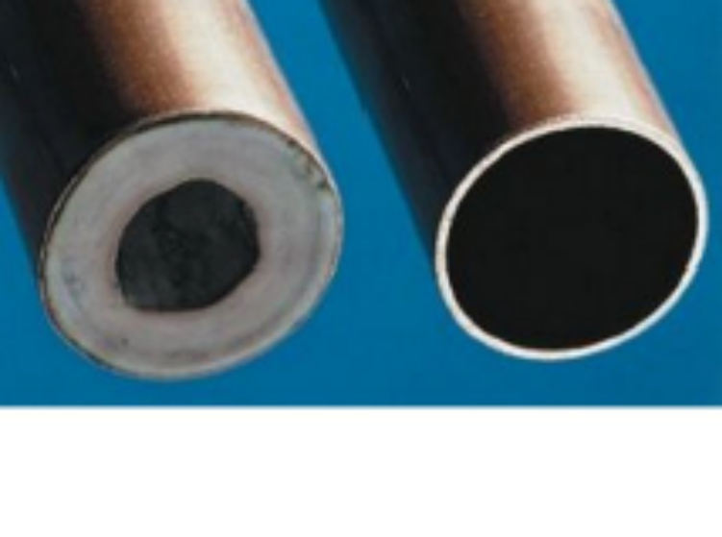
Hard and Soft Water
Millions of Heat exchangers, Cooling towers are currently operating with several hundred plugged tubes as a direct result of heavy scale formation. Water analysis has determined that the primary component of the plugging material is Temporary Hardness Ca(HCO₃)₂ a non-soluble form of lime-scale.
Watch® has noticed, the formation of process scale within heating and cooling equipment would not be noteworthy occurrence, except that these Heat exchangers are plugging on the water side instead of the process side of the tubes.+

Slide 6
Why Huge Problems
Scale build-up in all heating systems or in piping systems are because of the hard water and the alkaline processes and effluent streams. Scale severely restricts flow, which increases head loss and necessitates piping replacement and also off-line cleaning.
Method used in the past to add phosphates and phosphonates with scale inhibitors in the Heat exchangers, Cooling towers and any other process are severe problems. The use of phosphonates mineral acids can result in large pH swings in all water systems, resulting in significant increase in corrosion within the water distribution systems and all other process systems.

Slide 7
Why Huge Problems (continued...)
Premature equipment failure is programmed in advance because of the increased corrosion levels resulting from pH swings. The addition of all liquid phosphates, phosphonates, HDPE or ATMP based antiscales increases the operating cost of the system, resulting in environmental problems and economic difficulties.
Another potential method to destroy environmental of controlling water hardness exist that is ION EXCHANGE systems, reverse osmosis systems but their running costs, maintenance costs, chemical and salt costs are prohibitive and very soon they are prohibited.

Slide 8
The Chemestry
Only one potential method of controlling the pH of water system to a level 7.5 and to prevent scale formation without subjecting the system to the excessive pH swings is by taking the benefits of free CO2 in hard water.
Ca(HCO₃)₂ -> CaCO₃ + H₂O + C0₂
Figure 1
The concentration of HCO₃- is highly pH-dependent and tends to be at its maximum at a pH of approximately 8.5, which is roughly the same pH of all process water systems in the world. At a pH near 8.5, the systems are uniquely suited to force lime scale out of the solution and to form scale.

Slide 9
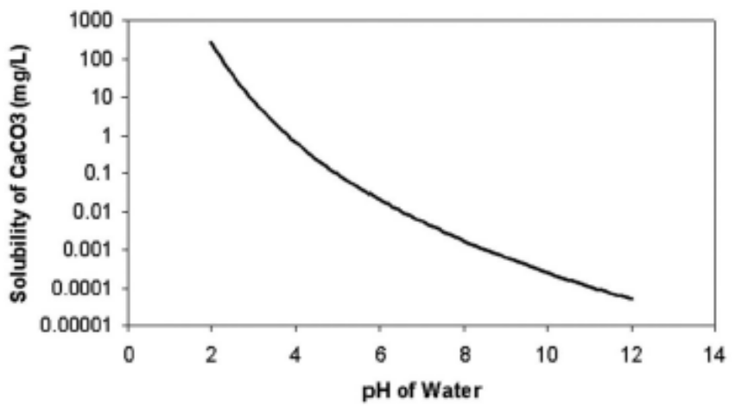
The Chemestry
An aqueous solution that resists changes in pH when acid or base is added is known to have sufficient buffering capacity. Atmospheric carbon dioxide produces a natural buffer and is the most important buffer system in water and wastewater treatment.
CO2 (g) ↔ CO2 (aq) + H2O
CO2 (aq) + H2O ↔ H2CO3
H2CO3 ↔ H+ + HCO3-
HCO3- ↔ H+ + CO32-
CO2 equilibrium
carbonic acid
carbonic acid
carbonate
CO2 in solution [CO2(aq)] is in equilibrium with atmospheric CO2(g)
This is critical concept, because the change in any components in eqs. (a),(b), (c) or (d) will disrupt the equilibrium causing CO2 to either be released or to be dissolved into solution.
Fig. 3 - Solubility of calcium carbonate
(lime scale) in water as a function of pH.

Slide 10
Benefits of FILTERSPORB SP3 Systems
Using the FILTERSORB SP3 system and changing calcium carbonate into solid state and at the same time fixing the pH of the solution it is possible to dissolve lime scale at this pH. As can be seen in Fig:2 as the pH drops from around 8.5 to around 7.5 the solubility of lime scale in water increases tenfold.
The sudden increase in lime scale solubility with a drop in pH from 8.5 to 7.5 suggests that a small decrease in pH of any process water system is sufficient to eliminate the lime scale problems and de- scale the existing scale On-Line without the shut off the system. Only about 10 mg of CO2 would be required to lower the system pH to about 7.5 and very important with 7.5 pH target, all potential corrosion issues should be substantially solved.

Slide 11
Super fast removal of existing scale
FILTERSORB SP3 + I-SOFT DESCALER
To descale the Heat Exchangers, Cooling towers, condensers or any other systems WITHOUT STOPPING PLANT/ PROCESS which is ON-LINE DESCALING
ISOFT – DESCALER (Click here: see detail on this link)
Most effective, safest and most economical descalant.
Quantity required is very less because of Instant powder I-SOFT DESCALER. Can be used for hardest scale and heaviest depositions of both scale and silica.
Can be closed directly after FILTERSORB SP3 system into heat exchangers, cooling towers, condensers which are without stooping the plant or process.
I-SOFT DESCALER offers the highest corrosion protection on metals.

Slide 12
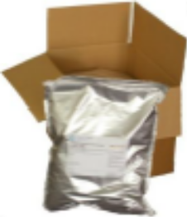
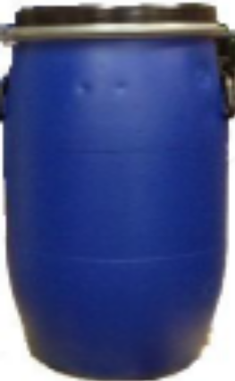
Scale removal= Lower energy costs
Safe: won’t harm environments and workers
Fast: Equipment is cleaned in few days without stopping the process because of its powerful detergent and penetrating agents.
Most Ideal for: On-Line Cleaning
Can be used in:
Heat Exchangers
Cooling Towers
Chillers
Condensers
Water Systems
Safe on:
Steel
Copper
Iron
Plastic
Brass
Rubber
Packaging:
I-SOFT® DESCALER (ISD) is packed in 1 kg,
2 kg and
5 kg bags
or 60 kg drums
For 24 hours complete
Descaling
Use i-soft- descaler
World’s safest and most effective
Descaler
End of Part V
Thanks for reading!

Slide 13
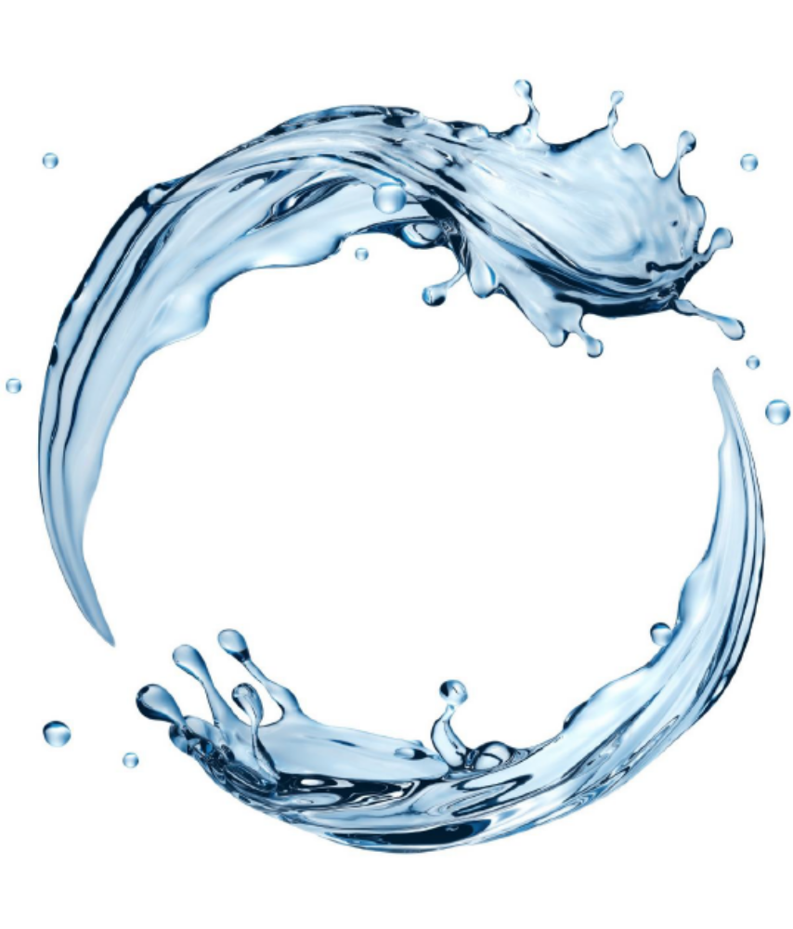

Watch Water® GmbH
Fahrlachstraße 14
68165 Mannheim
Germany
www.watchwater.de
info@watchwater.de
+49 (o)621 87951-0

