Slide 1


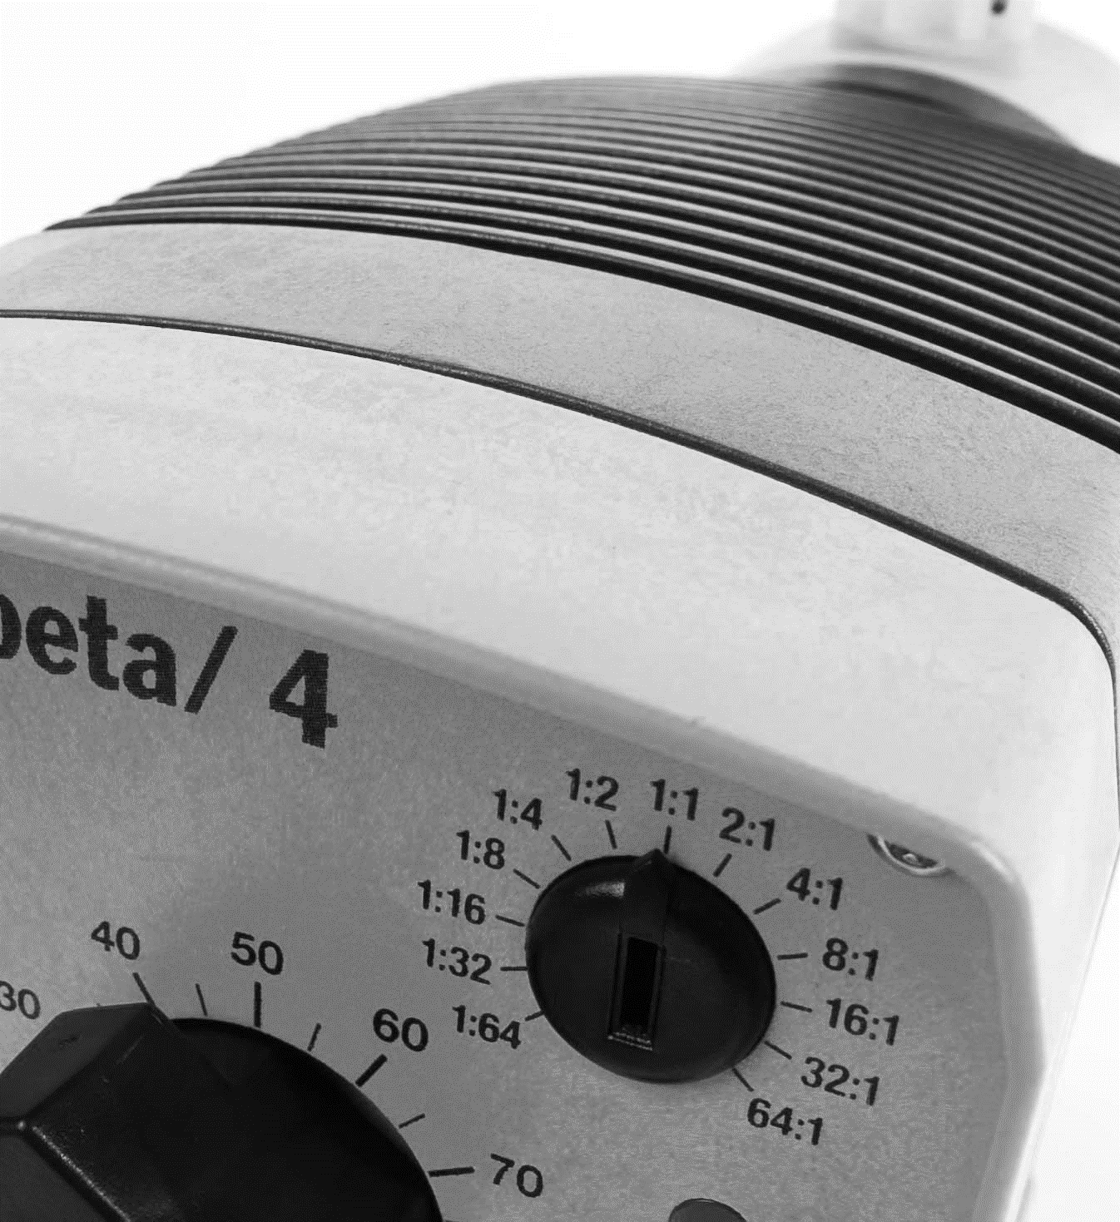
We make a difference.
REACH
Introduction
This solenoid metering pump Beta b is equipped with all adjustment and activation functions for modern water treatment and the dosing of chemicals. It has pulse step-up and pulse step-down compared with the preceding model. This enables it to adapt more precisely to external signal generators. The result is the simpler and more precise adjustment of chemical consumption to the actual need. It also has a 10 percent increase in efficiency and energy efficiency over the preceding model. The Beta b can be simply adjusted during operation.
REACH
Page
1
The Beta Pump consists of two main components: the pump drive unit and the liquid end.
Units offer maximum backpressure up to 363 psig (17.5 bar). Capacity range for the Beta/4 is 0.19 to 5 gph (0.74 to 19 l/h).
Feed rate is determined by stroke length and stroking rate: stroke length can be varied from 0 to 100% with an adjustment ratio of 10:1/ The stroke length set manually by the adjustment knob on the front of the pump.
Stroke rate can be adjusted in 10% increments between 10 and 100% via the multifunction switch. This switch is also used to select voltage-free On/Off external pulse contact, pump stop, or test (for priming).
Capacity range
0.28 l/h, 4 bar
REACH
The virtually wear-free solenoid drive
guarantees an exceptionally long service life even under
maximum load.
www.watchwater.de

Slide 2
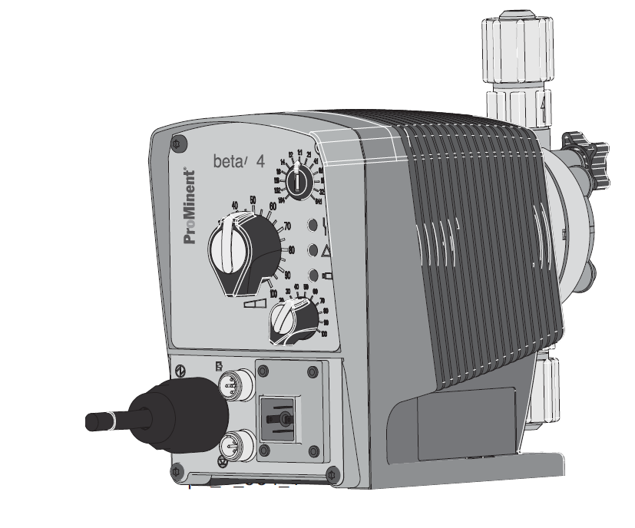
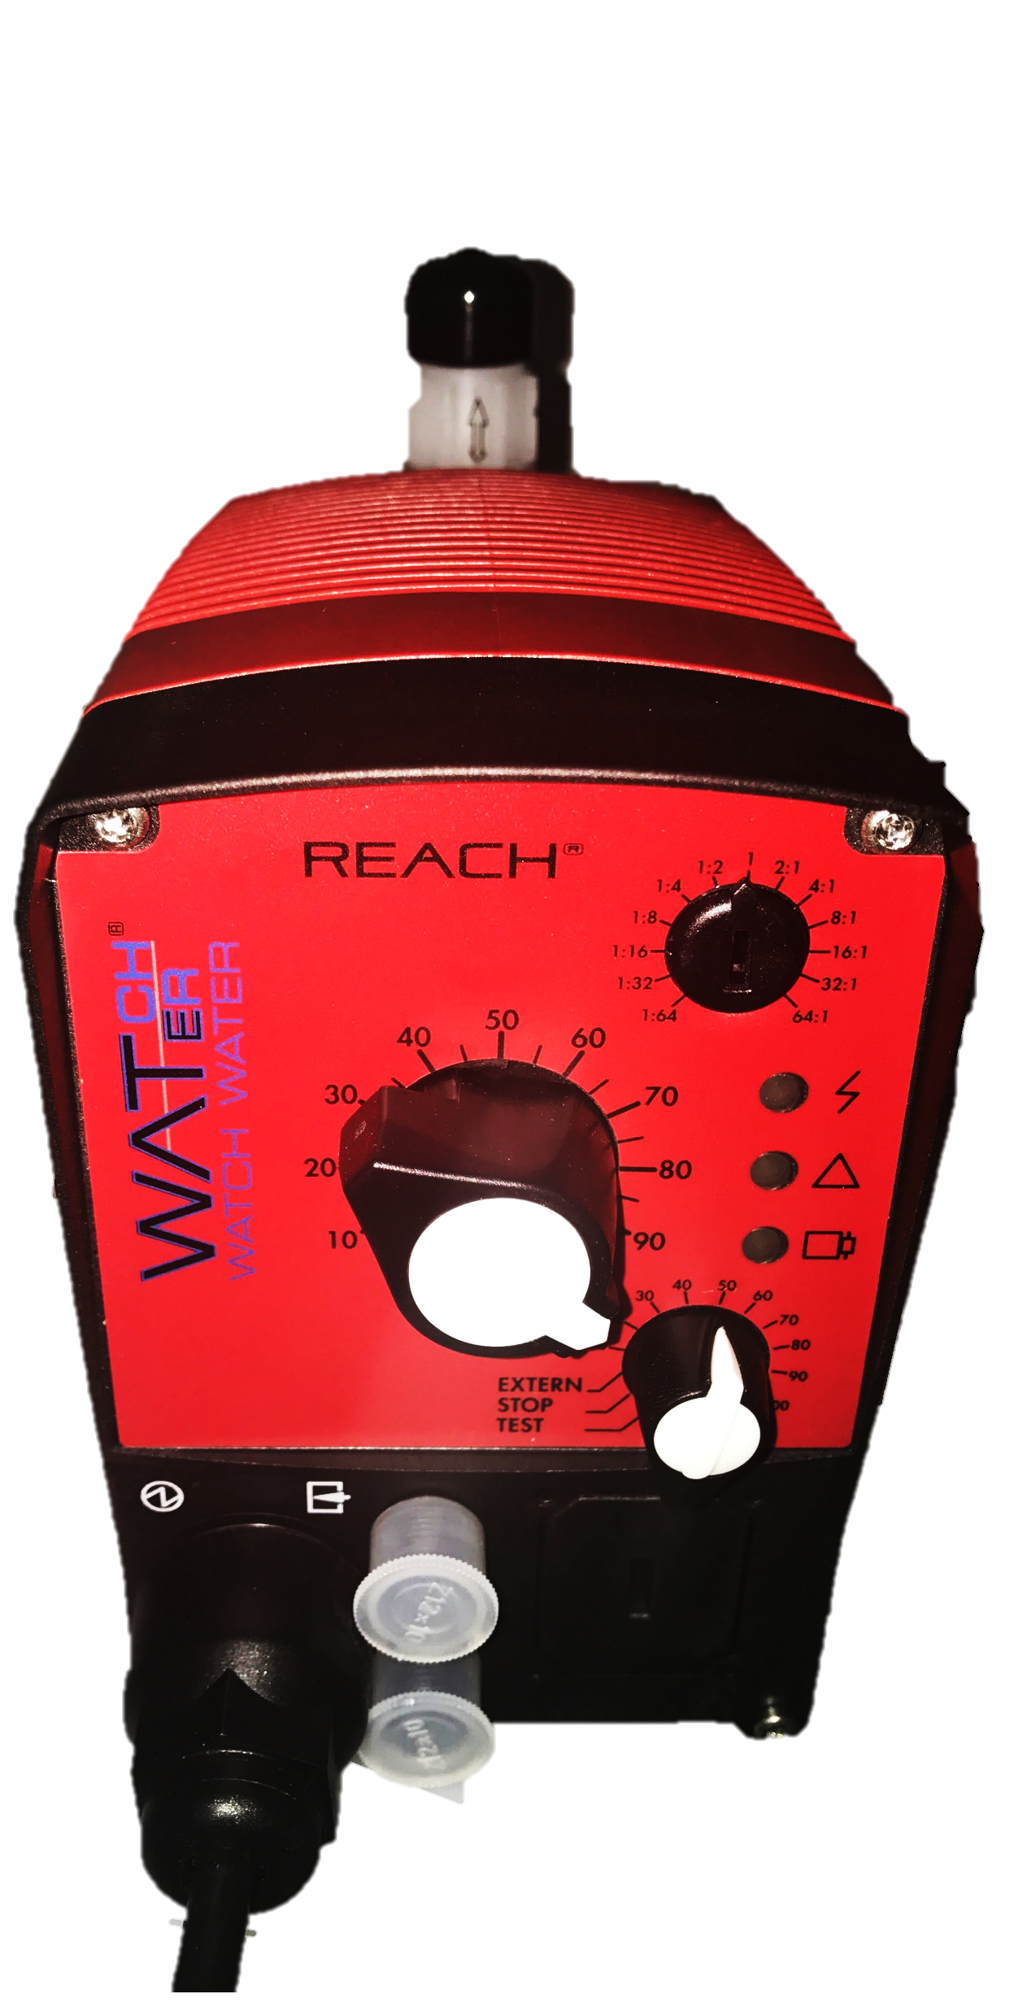
We make a difference.
Ideal for basic chemical feed applications
Capacity range 0,28 l/h, 4 bar
External contact input for pulse control with a range of 1:64-64:1
Continuous stroke length adjustment from 0-100% (recommended 30-100%)
Supplied in PVDF
Auto-degassing liquid end in Acrylic/PVC
10-setting stroke frequently adjustment from 10-100%
External control via voltage-free contacts
Connector for two-stage level switch
12-24V DC, 24 V AC low voltage version
LED’s for operation status
NSF/ANSI 61 approved
REACH
Benefits
Optional external control via 0/4 – 20 mA and potential free contacts with pulse step-up and step-down of 32:1 to 1:32
Simple adjustment of metering capacity via stroke rate and stroke length
Adaptation to existing signal transducers by external control via potential-free contacts with pulse step-up and step-down
Suitable for use with almost all liquid chemicals thanks to the available material combinations: PP, PVDF, clear acrylic, PTFE and stainless steel
Self-bleeding dosing head design in clear acrylic/PVC and PP
Virtually wear-free solenoid drive: economical and overload-proof
Page
2
REACH
Field of application
Metering liquid media in water treatment and chemical processes
www.watchwater.de

Slide 3
We make a difference.
Specifications (Cont.)
Maximum stroke length | 0.05’’ (1.25 mm)
Materials of construction Housing Diaphragm | Fiberglass reinforced PPE PTFE-faced EPDM with plastic core
Liquid end options | PVDF
Enclosure rating | IP 65
Motor insulation class | F
Power supply | 100-230 VAC, 1 phase, 50/60 Hz, +/- 10%< 12-24 VDC or 24VDC (x/-10%)
Check valves | Double ball
Metering repeatability | When used according to operating instructions, +- 2% under constant conditions and at minimum 30% stroke length
Power cord | 6 ft (2 m)
Relay cable (optional) | 6 ft (2 m)
Relay load Fault relay only (options 1&3) | Contact load: 250VAC, 2 A, 50/60 Hz Operating life: > 200,000 switch functions
Fault and pacing relay (options 4&5) | Contact load: 250VAC, 2 A, 50/60 Hz Operating life: > 200,000 switch functions
Ambient temperature range | 14°F (-10°C) to 113°F (45°C)
Max. fluid operating temperatures | Material: PVDF Constant: 149°F (65°C) Short Time: 212°F (100°C)
Average power drain at maximum stroking rate (Watts) / current drain at pump stroke (Amps) | 17W / 0.7 A or 15 A (peak current for approx. 1 ɥs)
Service factor | 1.15
Warranty | 2 years on drive, 1 year on liquid end (extended warranties available
Valve threads | Metric thread for PVT. ½’’ MNPT connections are available
Max. solids size in fluid | Pumps with ¼’’ valves: 15ɥ - Pumps with ½’’ valves: 50ɥ
Controlling contact (pulse) | With voltage free contact, or with semiconductor sink logic control (NPN(, not source logic (PNP). With a residual voltage of <700 mV, the contact load is approximately 0.5 mA at + 5VDC. Pump ignores contacts exceeding maximum input rate
Necessary contact duration | 20ɥs
Recommend Viscosity | max. 200 cPs for standard liquid end max. 500 cPs for valve with springs max. 50 cPs for auto-degassing metering pumps max. 3000 cPs for high viscosity
Page
3
REACH
www.watchwater.de

Slide 4
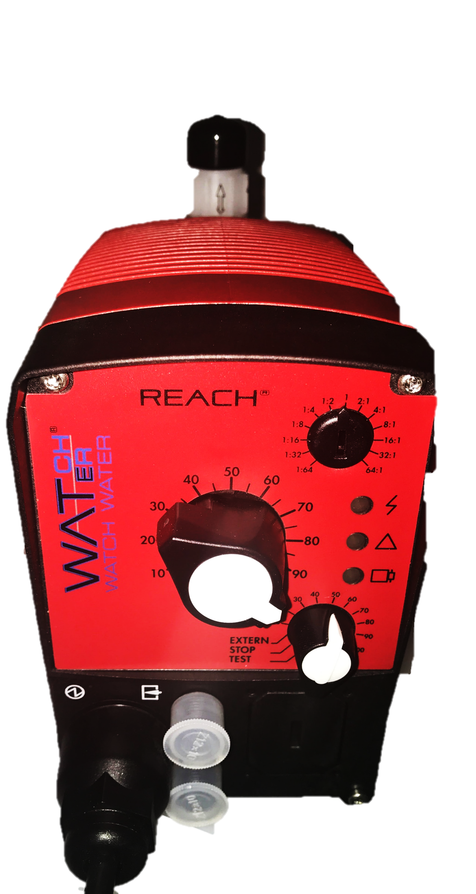
We make a difference.
Specifications
The stroke-length adjusting mechanism is connected directly to the solenoid. Adjustment results in an accurate self-looking stroke-length setting
Drive Unit
The pump housing is constructed of fiberglass-reinforced PPE plastic to protect against corrosion, dust and water.
The solenoid drive unit houses a short-stroke solenoid with a maximum stroke length of 0.05’’ (1.25 mm). It is equipped with a noise suppressing mechanism for quiet operation and the armature is the only moving part.
Operating on pulse action, each pulse generates a magnetic field in the solenoid coli. This magnetic field moves the armature, which in turn moves the diaphragm. The diaphragm pushes into the dosing head and cavity forces chemical out of the discharge valve. When the magnetic field is de-energized, a spring returns the armature and diaphragm to their original position. This return movement draws chemical into the dosing head cavity through the suction valve.
In the event of a diaphragm rupture, the liquid end has a weep hole on the bottom of the backplate to direct chemical out of the pump and away from the solenoid.
An optional diaphragm failure detector can be used to stop the pump and indicate a fault.
Diaphragm
The diaphragm is constructed of fabric-reinforced EPDM elastomer with a plastic core and PTFE-facing. It is chemically resistant to virtually all process fluids and can be used over a wide temperature rage. The Beta pump is designed with a convex diaphragm. The curved shape provides precise metering and alleviates stress placed on the diaphragm by reducing liquid end dead volume.
Watch-Water® GmbH
Fahrlachstraße 14
68165 Mannheim, Germany
Tel. +49 621 87951-0
Fax +49 621 87951-99
info@watchwater.de
Page
4
Technical Data
Shipping weight PV
kg | 2.9
Pump type | Delivery rate at max. back pressure |  |  | Delivery rate at medium back pressure |  |  | Connection size o ∅ x i ∅ Suction | Suction lift | Priming lift | Maximum priming pressure on suction side
Beta® b | bar | l/h | ml/ stroke | bar | l/h | ml/ stroke | mm | mWS | mWS | bar
BT4b 0402 | 4 | 2.8 | 0.26 | 2.0 | 3.6 | 0.36 | 6x4 | 6.0 | 2.5 | 5.5
Beta b Metering pumps with self-bleeding dosing head SEK
BT4b 0402 | 4 | 2.1 | 0.19 | 2.0 | 2.5 | 0.23 | 6x4 | 6.0 | 2.5 | 0.5
REACH
www.watchwater.de

